Slide 1
DetNet SRv6 Data Plane Encapsulation
draft-geng-dp-sol-srv6-01
Xuesong Geng (gengxuesong@huawei.com)
Mach Chen (mach.chen@huawei.com)
Yongqing Zhu (zhuyq.gd@chinatelecom.cn)

Slide 2
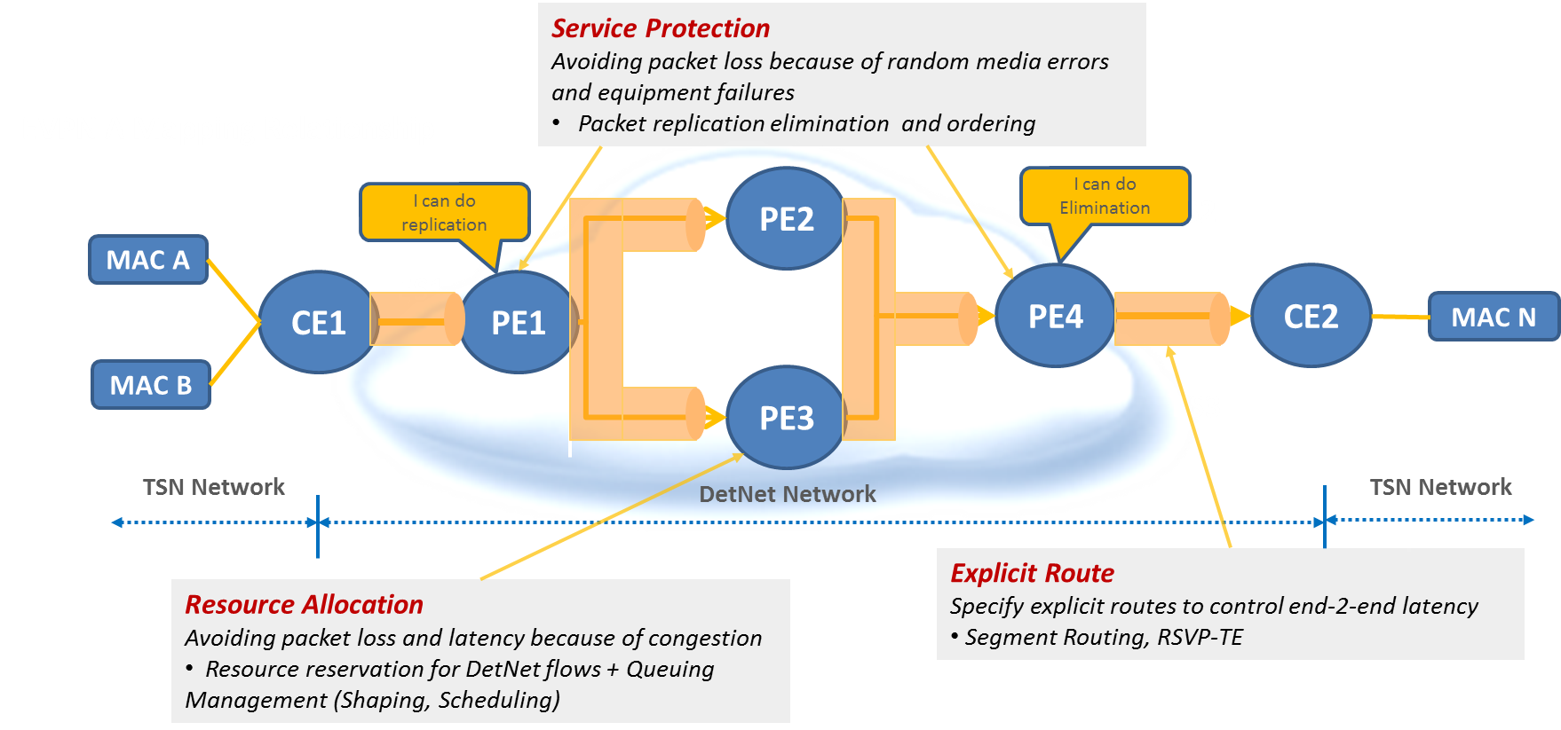
DetNet Overview
Key Features
DetNet provides a capability to carry specified unicast or multicast data flows for real-time applications with extremely low data loss rates and bounded latency within a network domain.
Key Technologies
Resource Allocation / Service Protection / Explicit Route

Slide 3
DetNet SRv6 Data Plane Requirement
A method of identifying the SRv6 payload type; (e.g., DSCP)
A suitable explicit route to deliver the DetNet flow ; (e.g., Segment List in SRH)
A method of indicating packet processing, such as PREOF; (detailed in next slides)
A method of identifying the DetNet flow; (detailed in next slides)
A method of carrying DetNet sequence number; (detailed in next slides)
A method of carrying queuing and forwarding indication to do congestion protection; (not covered in the current version)

Slide 4
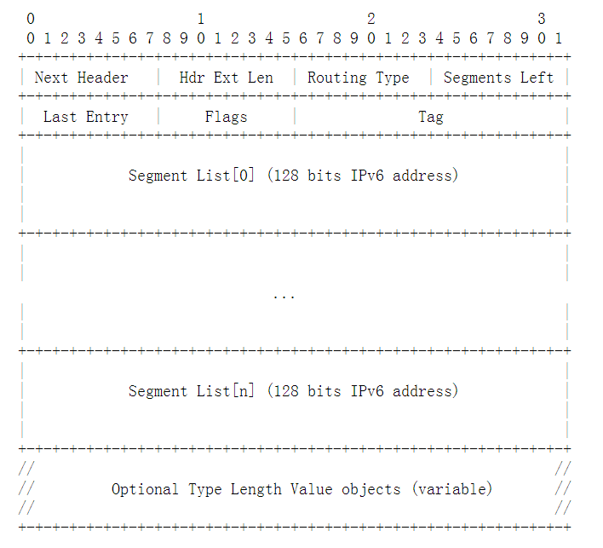
DetNet SRv6 Data Plane Solution
Flow Identification(20bits) and Sequence Number(28bits) are carried in:
Option1: SRH TLVs
Opiton2 : arguments in the SID for Relay Node
Option3: DetNet SID in segment list
2
3
1

Slide 5
SRv6 Based PREOF
SRv6
IPv6
IPv6 Header 2
IPv6
SRH 2
IPv6 Header 1
IPv6 Header 1
IPv6 Header
SRH 1
SRH1
IPv6 Header
IPv6 Header
Transit Node 1
End Station 1
Ingress
Relay Node 1
[Replication]
Relay Node 2
[Elimination]
Egress
End Station
2
Transit Node 2
IPv6 Header 4
IPv6 Header
IPv6 Header 4
SRH 4
IPv6 Header
SRH 4
IPv6 Header
IPv6 Header 3
IPv6 Header
SRH 3
IPv6 Header

Slide 6
Thanks

Slide 7
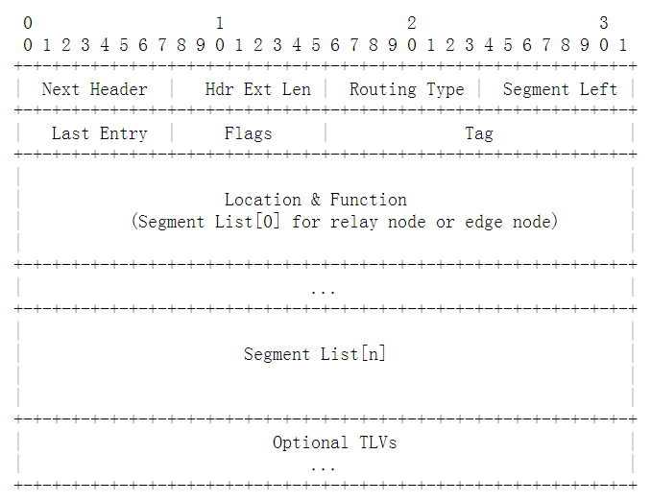
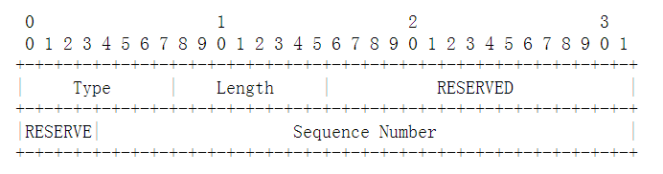
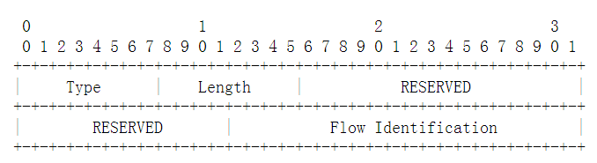
SRv6 Data Plane Solution Option1-Encapsulation
Flow Identification(32bits) and Sequence Number(32bits) are carried as TLVs
Type: 8bits, to be assigned by IANA.
Length: 8.
RESERVED: 28 bits, MUST be 0 on transmission and ignored on receipt.
Flow Identification: 20 bits, which is used for identifying DetNet flow.
SID for Relay Node
IPv6 Header
SRH
IPv6 Header
Payload
Type: 8 bits, to be assigned by IANA.
Length: 8.
RESERVED: 20 bits. MUST be 0 on transmission and ignored on receipt.
Sequence Number: 28 bits, which is used for indicating sequence number of a DetNet flow.

Slide 8
SRv6 Data Plane Solution Option1-Replication Function
End. B.Replication: Packet Replication Function
IF NH=SRH & SL>0 THEN
extract the DetNet TLV values from the SRH
create two new outer IPv6+SRH headers: IPv6-SRH-1 and IPv6-SRH-2 Insert the policy-instructed segment lists in each newly created SRH (SRH-1 and SRH-2). Also, add the extracted DetNet TLVs into SRH-1 and SRH-2.
remove the incoming outer IPv6+SRH header.
create a duplication of the incoming packet.
encapsulate the original packet into the first outer IPv6+SRH header: (IPv6-SRH-1) (original packet)
encapsulate the duplicate packet into the second outer IPv6+SRH header: (IPv6-SRH-2) (duplicate packet)
set the IPv6 SA as the local address of this node.
set the IPv6 DA of IPv6-SRH-1 to the first segment of the SRv6 Policy in of SRH-1 segment list.
set the IPv6 DA of IPv6-SRH-2 to the first segment of the SRv6 Policy in of SRH-2 segment list.
ELSE
drop the packet

Slide 9
SRv6 Data Plane Solution Option1-Elimination Function
End. B. Elimination: Packet Elimination Function
IF NH=SRH & SL>0 & "the packet is not a redundant packet" THEN
do not decrement SL nor update the IPv6 DA with SRH[SL]
extract the value of DetNet TLVs from the SRH
create a new outer IPv6+SRH header
insert the policy-instructed segment lists in the newly created SRH and add the retrieved DetNet TLVs in the newly created SRH
remove the incoming outer IPv6+SRH header.
set the IPv6 DA to the first segment of the SRv6 Policy in the newly created SRH
ELSE
drop the packet

Slide 10
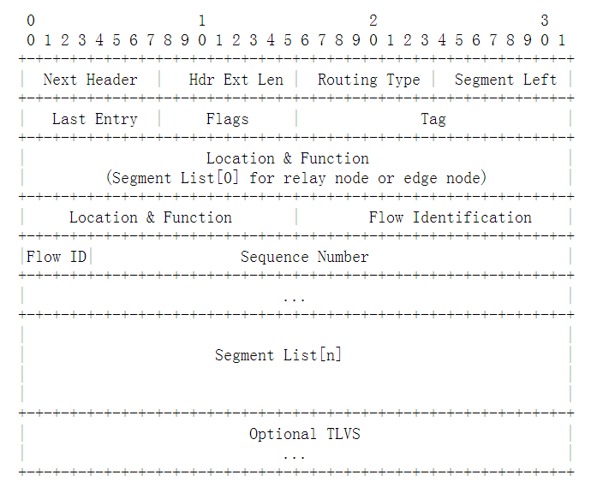
SRv6 Data Plane Solution Option2-Encapsulation
Flow Identification(20bits) and Sequence Number(28bits) are carried as arguments in the SID for Relay Node
Location & Function: the 80 most significant bits that are used for routing
Flow Identification: 20 bits, which is used for DetNet flow identification in the DetNet relay node;
Sequence Number: 28 bits, which are used for dis crime packets in the same DetNet flow;
IPv6 Header
SID for Relay Node
SRH
IPv6 Header
Payload

Slide 11
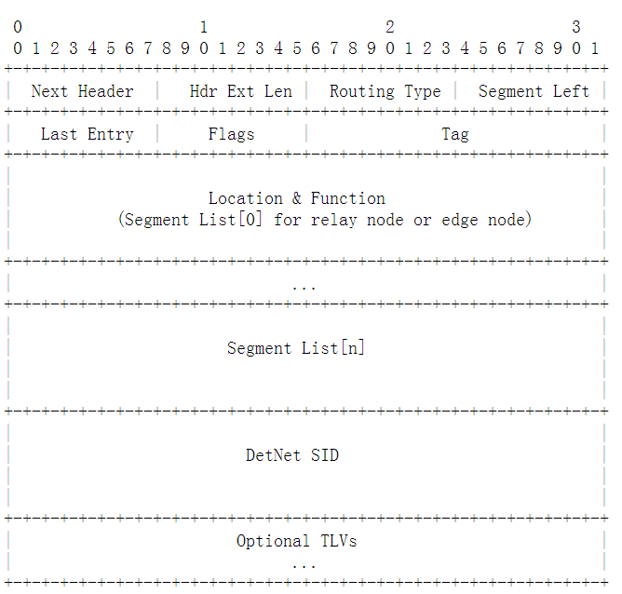
SRv6 Data Plane Solution Option3-Encapsulation
Flow Identification and Sequence Number are carried as in DetNet SID
SID for Relay Node
IPv6 Header
SRH
IPv6 Header
Payload
SID for DetNet

Slide 12
DetNet SRv6 Data Plane Solution Example
SRv6
IPv6
(R1,T2)
IPv6
(In,R1)
(R2,T2;SL=1)
(R2,T4)
(R1,T1;SL=1)
(ES1,ES2)
(Eg,T4;SL=2)
(ES1,ES2)
(ES1,ES2)
T1
T2
T4
In
R1
T3
R2
(R2,Eg)
Eg
End
Station 2
End Station 1
(In,T1)
(R1,T2)
(Eg,T4;SL=1)
(R2,T2;SL=2)
(R1,T3)
(ES1,ES2)
(ES1,ES2)
(R1,T1;SL=2)
(ES1,ES2)
(ES1,ES2)
(R2,T3;SL=1)
(ES1,ES2)
(ES1,ES2)
(R1,T3)
(R2,T3;SL=2)
(ES1,ES2)

